Slide 1
Week 1

Slide 2
Concepts to focus on

Slide 3
Independent Variable

Slide 4
Dependent Variable

Slide 5
Categorical Variable

Slide 6
Binary Variable
Dichotomous variable

Slide 7
Nominal

Slide 8
Ordinal

Slide 9
Continuous Variable

Slide 10
Interval

Slide 11
Ratio

Slide 12
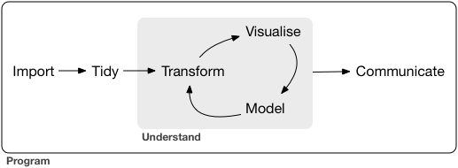
Analysis process

